Slide 1
Jawun Secondment Program Overview

Slide 2



Jawun Secondment Program Overview
HIGHLIGHTS:
ANU in partnership with Jawun, will offer secondment opportunities that see the diverse capabilities of ANU Professional and Academic staff seconded to regions that:
Target Audience: ANU Senior Staff
Duration: 6 Weeks
Occurrence: 4 Rounds, Yearly
Locations: Far West Coast, Lower River Murray region and East Kimberley
Build the capacity of Indigenous individuals and organisations
Assist Indigenous people to access mainstream economic and educational opportunities; and
Assist Indigenous people to bring about health and social reform
In return, ANU Staff will:
  Broaden their leadership skills and networks
  Enrich their professional development; and
  Increase their understanding, value and recognition of Aboriginal and Torres Strait Islander Cultures, histories and knowledges.
Secondees depart home location and arrive in Secondment location
Project Work concludes and Secondee debrief occurs
Kick off and onboarding
Induction Commences
Project Work Commences
Secondees depart for home location
Secondment debrief with ANU occurs
Participation in the Jawun Alumni Network
R1: Oct - Nov
R1: 27 Feb
R1: 28 Feb
R1: 3-7 Mar
R1: 6-8 Apr
R1: 8-9 Apr
R2: Feb - Mar
R2: 8 May
R2: 9 May
R2: 12-16 May
R2: 15-17 June
R2: 17-18 June
One week post Secondment
Ongoing
R3: Apr - May
R3: 31 July
R3: 1 Aug
R3: 4-8 Aug
R3: 4-8 Aug
R3: 7-9 Sep
R4: June - Jul
R4: 23 Oct
R4: 24 Oct
R4: 27-31 Oct
R4: 30 Nov–2
Dec
R4: 2-3 Dec
2

Slide 3




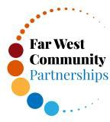


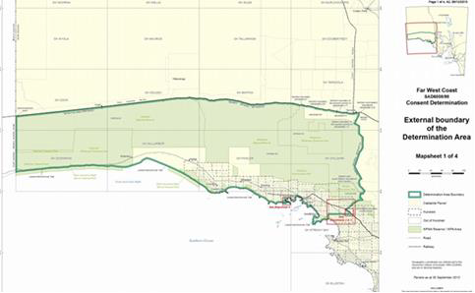
Far West Coast
The Far West Coast Region has an Aboriginal population of approximately 1,100 people and five large Aboriginal communities – Oak Valley (100), Yalata (294), Scotdesco (80), Koonibba (150), and Ceduna (500). The characteristics of the region include over 2,000kms of coastline, a growing Aboriginal population and a diversity of industries comprising agriculture, manufacturing, fishing, aquaculture and tourism, and fast emerging mining and renewable energy sectors.
Far West Coast Community Partnerships
Yalata Anangu AC
Yadu Health AC
Ceduna Aboriginal Corporation
Oak Valley (Maralinga)
Far West Coast Aboriginal Corporation
Community Census
HR process review and support
IT review and dashboard (PowerBI) support
Education reform
Ranger intern program scoping
Annual operational planning process
Employment Hub Development
Arts and Culture Centre Business Planning and Philanthropic Funding support
Team and workplace culture development
Regional economic
development plan
Health Centre re- development - planning
Strategic plan operationalisation mapping workshop
Aboriginal Tourism Strategy
3
DD MMM YY

Slide 4



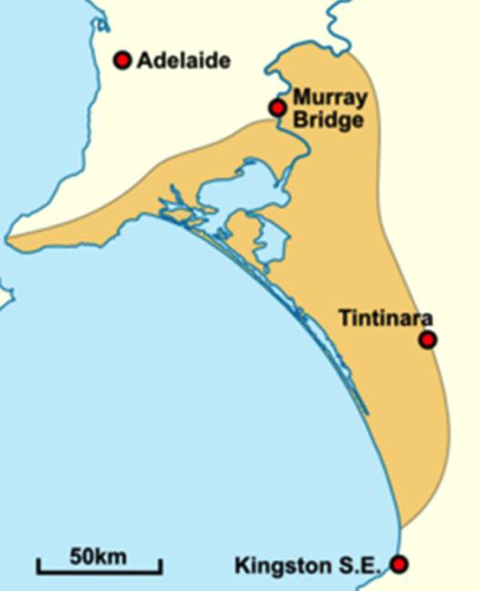

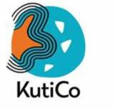
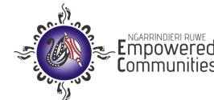
Lower River Murray, Lakes and Coorong
The Lower River Murray, Lakes and Coorong region is home to the Ngarrindjeri Nation. The Ngarrindjeri traditional area extends one hour south-east of Adelaide from Mannum, and downstream through Murray Bridge and Victor Harbor and along the coast through Goolwa to Cape Jervis, including Lake Alexandrina and Kurilpang (Lake Albert).
In this region, there is a strong desire among Ngarrindjeri people to create a future centred on caring for country, which incorporates respect for traditions, cultural responsibility and self-determination. Current initiatives are focused on health and wellbeing, land and water management and developing a sustainable Ngarrindjeri regional economy.
Kuti Co
Moorundi ACCHS
Ngopamuldi Aboriginal Corporation
Ngarrindjeri Ruwe Empowered Communities
Ngarrindjeri Lands & Progress Aboriginal Corporation
Strategic Planning
Health and Wellbeing and Business Service Hub development
IT review
Youth Leadership Program
Policy and process reviews, recommendations and implementation support
Business Expansion
Strategic Planning
Data dashboards and
IT review
Operational Governance
It systems review, recommendations implementation support
Website development, marketing and brand development
Wildflower Business review, inc. harvest forecasting review, distribution and marketing
NDIS scoping and service delivery plan
4
Asset and insurance review
Soft plastics recycling infrastructure and development

Slide 5






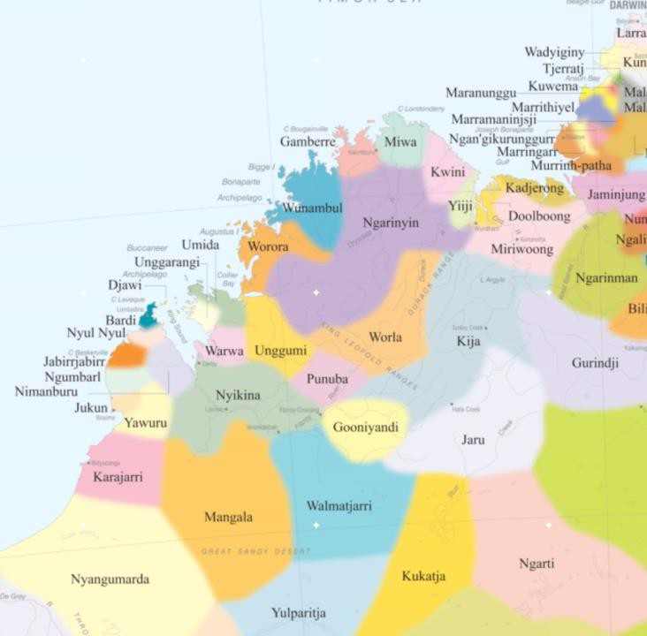

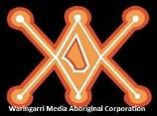



East Kimberley
The Kimberley region is located in far north Western Australia, comprised of the West Kimberley towards the coast and the East Kimberley towards the Northern Territory border. Jawun began working with the Indigenous communities of the East Kimberley in 2010, and in 2012 broadened its boundaries to include communities in the West Kimberley region.
The East Kimberley region includes the towns of Kununurra, Halls Creek and Wyndham and over 50 smaller communities – extending all the way from Balgo in the south, to Kalumburu and Ooombulgurri in the north, and Malangan near the Northern Territory border.
All East Kimberley Indigenous Regional Organisations
HR – Organisational restructures
Leadership – Training and Development, Mentoring/Training Programs Planning – Annual, Business and Strategic Plan reviews
•
Wunan, MG Corporation, Waringarri AC (ACCOs)
Empowered Communities BBYAC
Warringarri Arts
Mirima Language Centre
EKJP, Wayfinder
IT review, systems (CRM), website development, dashboards (Wunan/EC)
Mentoring program through Employment Roundtable
HR – Succession Planning, Awards Review
Curriculum inclusion (Dept. Ed), Training and Development, marketing/grants.
NDIS Support
Enterprise development – property, small business, grants.
5

