Slide 1


SAGE Athena SWAN Pilot
Information for ANU Humanities and Social Sciences staff

Slide 2
Gender representation: all ANU students and academic staff 2016
Notes:
Let’s begin by looking at the split of males to females among our academic staff at ANU. This graph shows the data for all colleges and disciplines across ANU, and we can see that we are losing women from the academic career pipeline.
At Level A there are roughly 45% females and 55% males. However, at Levels D and E there are three times as many men as there are women.

Slide 3
Gender representation: HASS academic staff 2018
Notes:
There is a misconception that the gender gap only affects STEMM. This graph shows that there is also an imbalance in the numbers of men and women in the Humanities, Arts and Social Science disciplines as well, with a sharp decrease in the numbers of women occurring in the transition from Level B to Level C.

Slide 4
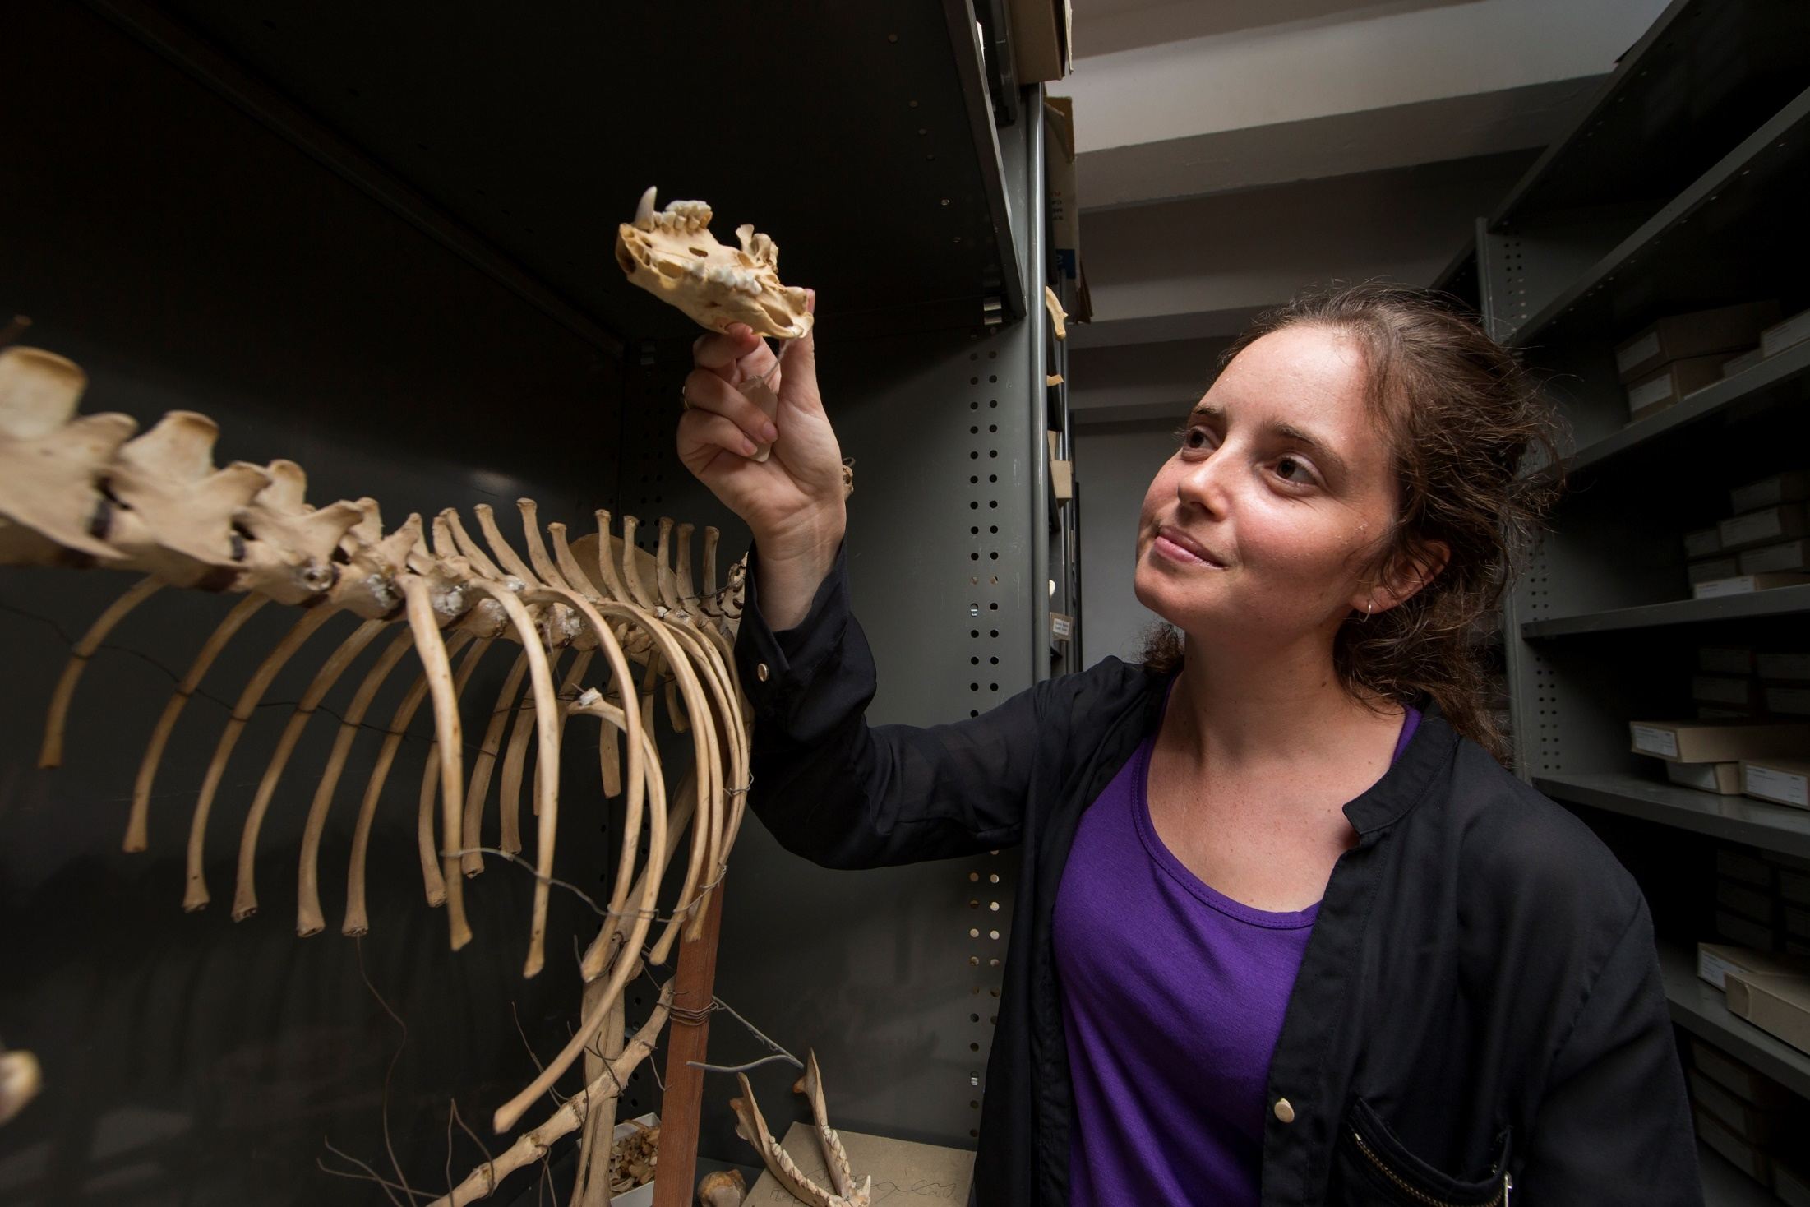
Why do we need gender equity?
The loss of female researchers reduces our capacity for world-class research and innovation.
ANU will not operate to its full potential unless all staff have an equal voice and equal opportunities to excel, regardless of gender.
Notes:
The loss of female researchers is a significant waste of knowledge, talent and investment. As a University, it impacts on our capacity for world-class research and innovation.
More broadly, this loss of talent has an impact on our nation’s academic performance and productivity.

Slide 5
Diverse and inclusive organisations:
are more innovative and creative ¹
have higher employee satisfaction ²
have lower rates of staff turnover ³
Notes:
So why is ANU focusing on equity and diversity?
Not only because it’s the right thing to do, but also because it benefits staff and the University as a whole.

Slide 6
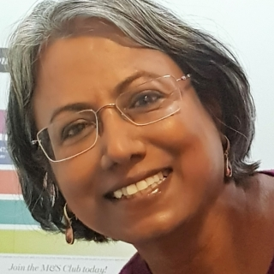
“When I first joined the old Research School of Pacific and Asian Studies, I arrived in an ANU that was intensely white and extremely masculine.
Working there was not easy, if at all, it was intimidating.”
Professor Kuntala Dutt
Crawford School of Public Policy

Slide 7
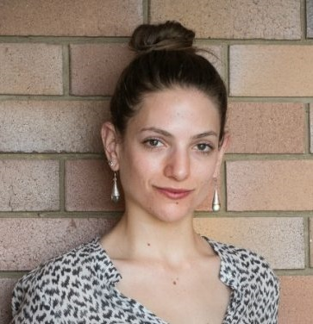
“In the discipline of philosophy I am yet to meet a single woman who has not been sexually harassed by a more senior academic at a conference.
It comes as no surprise to me that the drop-out rate for women is vastly higher than it is for men, and that there are few women occupying senior academic positions in this discipline.”
Emma Davies
PhD candidate in Philosophy
and Women’s Officer, PARSA

Slide 8
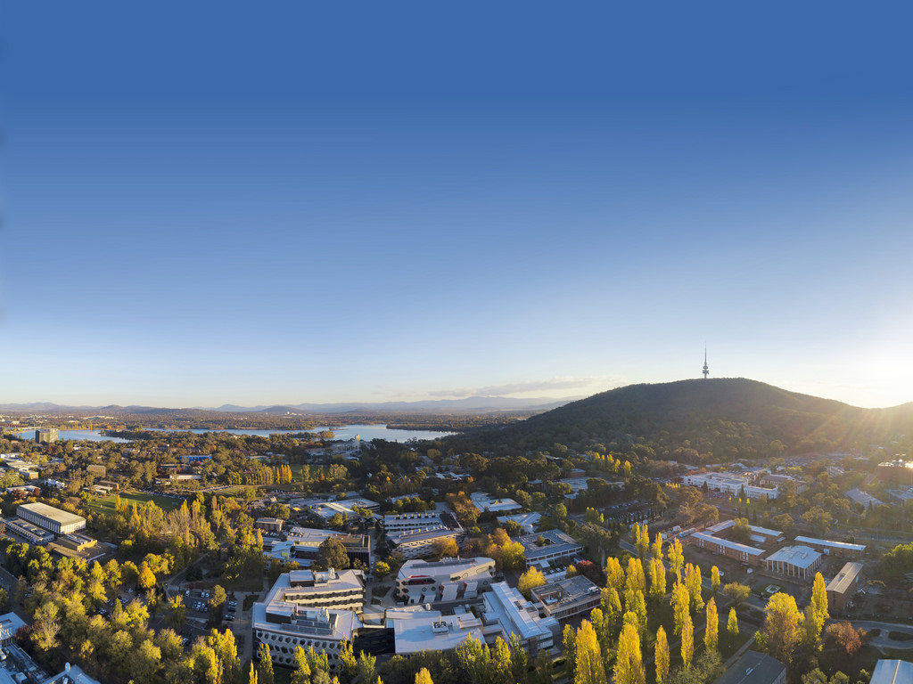
ANU is committed to creating an inclusive environment where all staff have the opportunity to reach their full potential.
The ANU Strategic Plan 2018 – 2021 (3.1) sets a goal of achieving an Athena SWAN Bronze institutional award by 2019.
Notes:
The ANU is committed to addressing gender inequity and actively working towards building a more inclusive workplace – this has been embedded in the current Strategic Plan.

Slide 9

Our commitment to gender equity
Notes:
In this video, ANU Vice-Chancellor Professor Brian Schmidt speaks about the need to make ANU more equitable and inclusive.
He shares some of the background on why ANU decided to take part in the SAGE pilot of the Athena SWAN charter, and how we will benefit from it.

Slide 10

What is SAGE?
SAGE is a national program promoting gender equity and diversity in STEMM through the Australian pilot of the Athena SWAN Charter.
Established 2014, partly in response to the fact that no women were shortlisted for the Australian Academy of Science Fellowships in 2013
SAGE is run by Australian Academy of Science, in partnership with the Academy of Technology and Engineering (ATSE)
Notes:
So what is SAGE, and how did it come about?
In 2013, the Australian Academy of Science realised that there was a significant problem with a gender imbalance in Australia’s scientific community.
In response, they established Science in Australia Gender Equity – or SAGE – to explore options for advancing gender equity in Australian STEMM disciplines.
SAGE is piloting the Athena SWAN Charter in Australia – so far 45 institutions have signed on as members of this initiative.

Slide 11
What is Athena SWAN?
The Athena SWAN Charter is an evaluation and accreditation program
The Charter recognises excellence in employment practices that advance the careers of women and gender minorities
To read the Ten Principles of the Athena SWAN Charter, see www.services.anu.edu.au/sage
Notes:
The Athena SWAN Charter is an evaluation and accreditation program, established in the UK in 2005.
It evolved through the Athena Project and the Scientific Women’s Academic Network (SWAN) – two initiatives that address the gender imbalance and inequities within STEMM higher education and research institutes.
Through Bronze, Silver and Gold Awards, the Charter recognises excellence in employment practices that advance and promote the careers of women and gender minorities in STEMM subjects.
It has had tremendous success in enhancing gender equity within research institutions in the UK.

Slide 12
While SAGE focuses on gender equity within the STEMM disciplines, ANU is committed to inclusion and diversity more broadly.
As part of the SAGE Athena SWAN project at ANU, we are working towards greater equity and inclusion within all disciplines and groups of staff across the University.
Notes:
You may be asking – why is this relevant to me?
It’s important to note that although SAGE focuses on gender equity in the STEMM disciplines, at ANU we are taking a broader view and committing to improving equity and diversity within not only STEMM but also HASS disciplines, and for professional staff.

Slide 13
SAGE Athena SWAN at ANU
Self-Assessment Team
Name | Area
Professor Mike Calford (Chair) | Provost
Professor Richard Baker | Pro Vice-Chancellor University Experience
Dr Nadine White | Director, Human Resources
Ms Richelle Hilton | Director, Planning and Performance Measurement
Professor Rae Frances | Dean, ANU College of Arts & Social Sciences
Professor Elanor Huntington | Dean, ANU College of Engineering & Computer Science
Professor Paul Pickering | Director, Research School of Humanities and the Arts
Professor Stephen Eggins | Director, ANU College of Science
Professor John Evans | College of Science
Notes:
The ANU Self-Assessment Team (SAT) is chaired by the Provost, Professor Mike Calford, and is supported by a small team of professional staff.
The SAT membership is diverse and includes staff from across the University.
The SAT’s role is to oversee, guide, prepare and submit the application for SAGE Athena SWAN institutional Bronze Award.

Slide 14
SAGE Athena SWAN at ANU
Self-Assessment Team (continued)
Name | Area
Mr Jamiyl Mosley | Head of Hall Burton & Garran Hall
Dr Jananie William | ANU College of Business & Economics
Professor Steve Blackburn | ANU College of Engineering & Computer Science
Associate Professor Kuntala Lahiri-Dutt | ANU College of Asia & the Pacific
Associate Professor Mark Nolan | ANU College of Law
Dr Joanna Sikora | ANU College of Arts & Social Sciences
Associate Professor Cathy Banwell | College of Health & Medicine
Dr Naomi Priest | ANU College of Arts & Social Sciences
Ms Sarah O'Callaghan | Manager, Facilities & Services
Ms Sara Rowley (Project Manager) | SAGE Project Manager, Human Resources

Slide 15
Project timeline
Stage 1
Data profiling
Stage 2
Existing data collected
Stage 3
Additional data collected
Stage 4
Action plan developed
Stage 5
Application submission 29 March 2019
Consultation forums
Links to colleges and research schools
Notes:
We’ve largely completed the initial data collection stages of the project, although some additional data collection and analysis is ongoing.
Shortly we’ll move into Stage 4 - the Self-Assessment team will develop a four-year action plan for gender equity at ANU. This action plan will be made available to all staff in early 2019.

Slide 16
Since joining the SAGE pilot of Athena SWAN, ANU has:
Gender equity progress at ANU
Expanded parental leave entitlements to include up to 26 weeks of paid parental leave for partners.
Increased funding through the Carer's Career Development Assistance Fund to support staff with caring commitments to participate in conferences or workshops.
Appointed a Dean of Staff, to assist staff in the early resolution of potential cases of discrimination.
Notes:
The University has made some progress in some aspects of gender equity and inclusion over the past few years. This is a start, but we know there is still a lot more to be done.

Slide 17
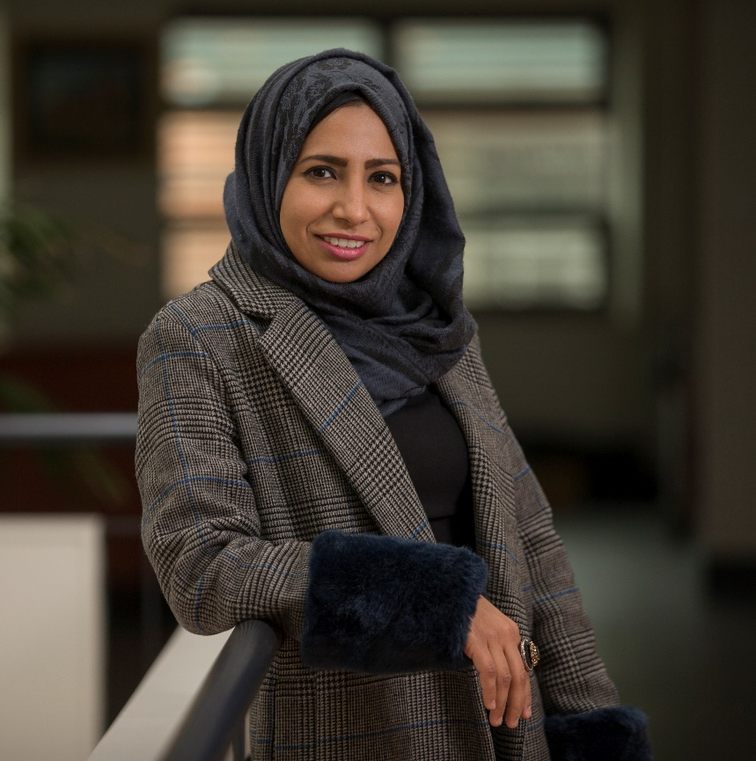
What gender inequities do you see at ANU?
Are there any gender equity issues that are specific to professional staff?
What changes do you want to see, to make ANU more inclusive and equitable?
📧 Contact us:
SAGE@anu.edu.au
🌐 Find out more:
services.anu.edu.au/sage
Notes:
Some questions for you to consider. We’d really appreciate your feedback and ideas.

Slide 18
📧 Contact us:
SAGE@anu.edu.au
🌐 Find out more:
services.anu.edu.au/sage
Notes:
We welcome your feedback on the project, and your suggestions for how we can make ANU a more inclusive and diverse place to work.

