Slide 1
SAGE Athena SWAN Pilot
Information for ANU STEMM Staff

Slide 2
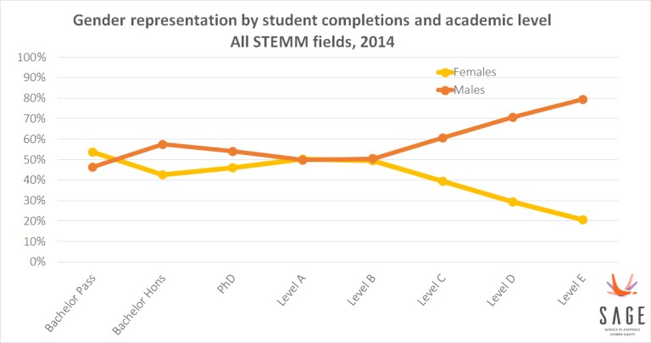
Gender representation in STEMM: Australia-wide
Notes:
We’ll begin by taking a quick look at this 2014 data from the Department of Education and Training, which shows that across Australia, women are underrepresented in STEMM fields, particularly at senior levels.

Slide 3
Gender representation in STEMM: ANU academic staff in 2018
Notes:
We can see that the gap between men and women is even more pronounced when we look at the data for STEMM staff at ANU.
As part of the SAGE Athena SWAN project at ANU, we want to understand why are we losing women from the academic pipeline?

Slide 4
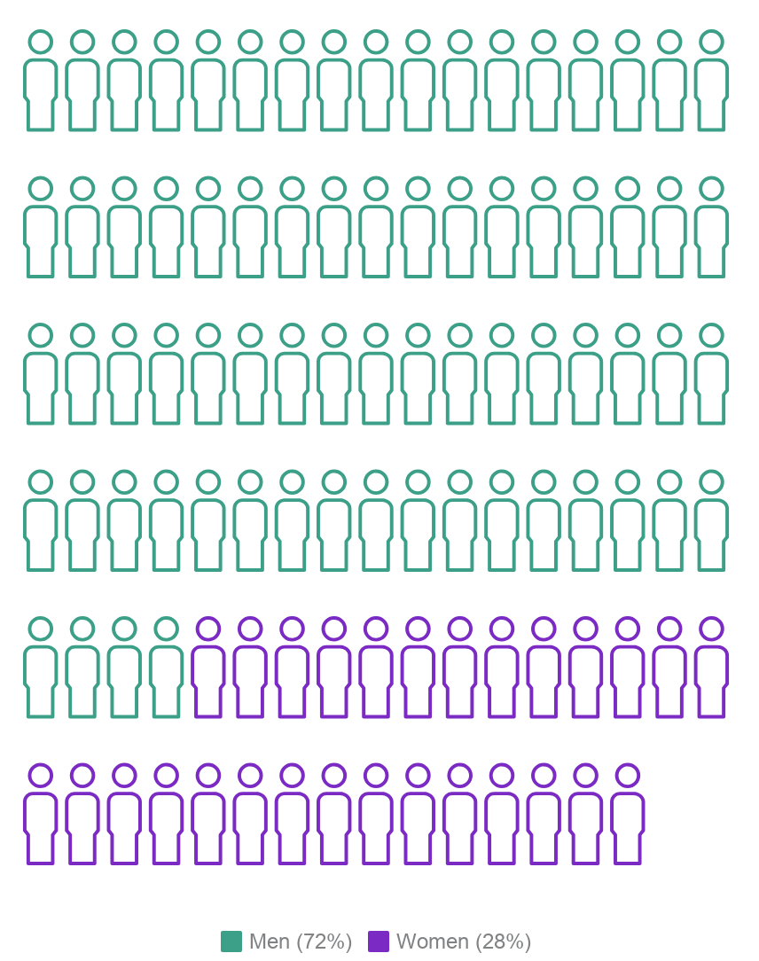
Roughly one quarter of senior academics (Levels D and E) at ANU are women.
Notes:
At ANU, we know that the gender imbalance is not restricted to STEMM, but also occurs in other disciplines as well.
Overall about 62% of academics at ANU are men, 38% are women, and this gap widens as seniority increases. Only 28% of staff at Levels D and E are women.

Slide 5
Why do we need gender equity?
The loss of female researchers reduces our capacity for world-class research and innovation.
ANU will not operate to its full potential unless all staff have an equal voice and equal opportunities to excel, regardless of gender.
Notes:
The loss of female researchers is a significant waste of knowledge, talent and investment. As a University, it impacts on our capacity for world-class research and innovation.
More broadly, this loss of talent has an impact on our nation’s scientific performance and productivity.

Slide 6
Diverse and inclusive organisations:
are more innovative and creative ¹
have higher employee satisfaction ²
have lower rates of staff turnover ³
Notes:
So why is ANU focusing on equity and diversity?
Not only because it’s the right thing to do, but also because it benefits staff and the University as a whole.

Slide 7
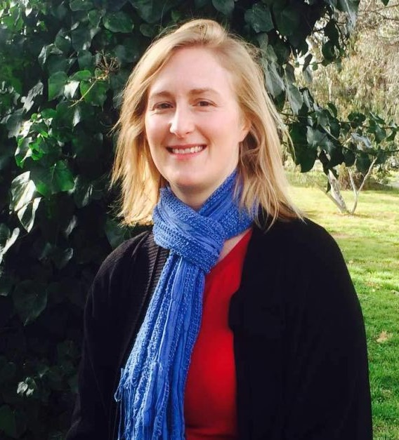
Women in STEMM at ANU
“Having children is something I have always wanted to do and I was not prepared to sacrifice that choice for my career, and I don't think any woman should have to do that.”
“We face a double disadvantage - whilst on maternity leave we don't generate data so we don't get any publications. This then means we are considered less productive and less competitive when it comes to attracting future funding.”
Dr Julia Ellyard John Curtin School of Medical Research

Slide 8
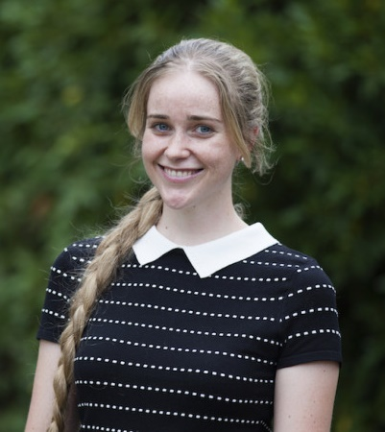
Women in STEMM at ANU
“I would love to see people become more aware of their unconscious biases and how these may be affecting other people.
One of the studied examples of biases towards women in science looked at how academics responded differently to emails from male and female students.
In a funny way it was a lucky accident that my parents gave me the name they did, because a lot of people I speak to over email think I’m a boy until they meet me.”
Toby Hendy PhD candidate in Physics & Westpac Future Leaders Scholar

Slide 9
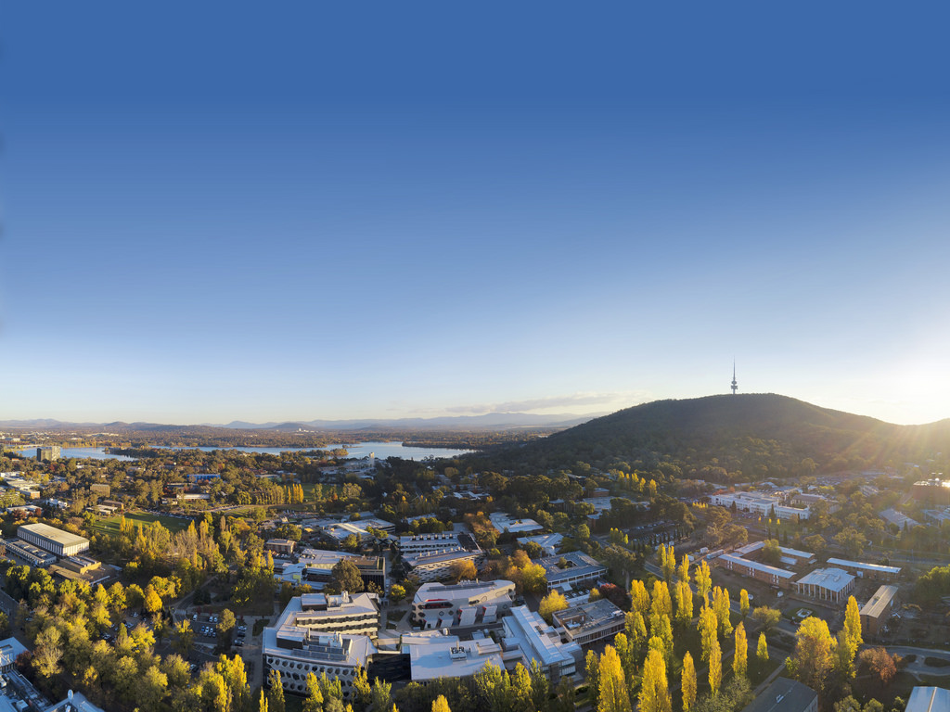
ANU is committed to creating an inclusive environment where all staff have the opportunity to reach their full potential.
The ANU Strategic Plan 2018 – 2021 (3.1) sets a goal of achieving an Athena SWAN Bronze institutional award by 2019.
Notes:
The ANU is committed to addressing gender inequity and actively working towards building a more inclusive workplace – this has been embedded in the current Strategic Plan.

Slide 10
Our commitment to gender equity
Notes:
In this video, ANU Vice-Chancellor Professor Brian Schmidt speaks about the need to make ANU more equitable and inclusive.
He shares some of the background on why ANU decided to take part in the SAGE pilot of the Athena SWAN charter, and how we will benefit from it.

Slide 11
What is SAGE?
SAGE is a national program promoting gender equity and diversity in STEMM through the Australian pilot of the Athena SWAN Charter.
Established 2014, partly in response to the fact that no women were shortlisted for the Australian Academy of Science Fellowships in 2013
SAGE is run by Australian Academy of Science in partnership with the Academy of Technology and Engineering (ATSE)
Notes:
So what is SAGE, and how did it come about?
In 2013, the Australian Academy of Science realised that there was a significant problem with a gender imbalance in Australia’s scientific community.
In response, they established Science in Australia Gender Equity – or SAGE – to explore options for advancing gender equity in Australian STEMM disciplines.
SAGE is piloting the Athena SWAN Charter in Australia – so far 45 institutions have signed on as members of this initiative.

Slide 12
What is Athena SWAN?
The Athena SWAN Charter is an evaluation and accreditation program
The Charter recognises excellence in employment practices that advance the careers of women and gender minorities
To read the Ten Principles of the Athena SWAN Charter, see www.services.anu.edu.au/sage
Notes:
The Athena SWAN Charter is an evaluation and accreditation program, established in the UK in 2005.
It evolved through the Athena Project and the Scientific Women’s Academic Network (SWAN) – two initiatives that address the gender imbalance and inequities within STEMM higher education and research institutes.
Through Bronze, Silver and Gold Awards, the Charter recognises excellence in employment practices that advance and promote the careers of women and gender minorities in STEMM subjects.
It has had tremendous success in enhancing gender equity within research institutions in the UK.

Slide 13
SAGE Athena SWAN at ANU
Self-Assessment Team
Name | Area
Professor Mike Calford (Chair) | Provost
Professor Richard Baker | Pro Vice-Chancellor University Experience
Dr Nadine White | Director, Human Resources
Ms Richelle Hilton | Director, Planning and Performance Measurement
Professor Rae Frances | Dean, ANU College of Arts & Social Sciences
Professor Elanor Huntington | Dean, ANU College of Engineering & Computer Science
Professor Paul Pickering | Director, Research School of Humanities and the Arts
Professor Stephen Eggins | Director, ANU College of Science
Professor John Evans | College of Science
Notes:
The ANU Self-Assessment Team (SAT) is chaired by the Provost, Professor Mike Calford, and is supported by a small team of professional staff.
The SAT membership is diverse and includes staff from across the University.
The SAT’s role is to oversee, guide, prepare and submit the application for SAGE Athena SWAN institutional Bronze Award.

Slide 14
SAGE Athena SWAN at ANU
Self-Assessment Team (continued)
Name | Area
Mr Jamiyl Mosley | Head of Hall Burton & Garran Hall
Dr Jananie William | ANU College of Business & Economics
Professor Steve Blackburn | ANU College of Engineering & Computer Science
Associate Professor Kuntala Lahiri-Dutt | ANU College of Asia & the Pacific
Associate Professor Mark Nolan | ANU College of Law
Dr Joanna Sikora | ANU College of Arts & Social Sciences
Associate Professor Cathy Banwell | College of Health & Medicine
Dr Naomi Priest | ANU College of Arts & Social Sciences
Ms Sarah O'Callaghan | Manager, Facilities & Services
Ms Sara Rowley (Project Manager) | SAGE Project Manager, Human Resources

Slide 15
Project timeline
Stage 1
Data profiling
Stage 2
Existing data collected
Stage 3
Additional data collected
Stage 4
Action plan developed
Stage 5
Application submission 29 March 2019
Consultation forums
Links to colleges and research schools
Notes:
We’ve largely completed the initial data collection stages of the project, although some additional data collection and analysis is ongoing.
Shortly we’ll move into Stage 4 - the Self-Assessment team will develop a four-year action plan for gender equity at ANU. This action plan will be made available to all staff in early 2019.

Slide 16
Since joining the SAGE pilot of Athena SWAN, ANU has:
Gender equity progress at ANU
Expanded parental leave entitlements to include up to 26 weeks of paid parental leave for partners.
Increased funding through the Carer's Career Development Assistance Fund to support staff with caring commitments to participate in conferences or workshops.
Appointed a Dean of Staff, to assist staff in the early resolution of potential cases of discrimination.
Notes:
The University has made some progress in some aspects of gender equity and inclusion over the past few years. This is a start, but we know there is still a lot more to be done.

Slide 17
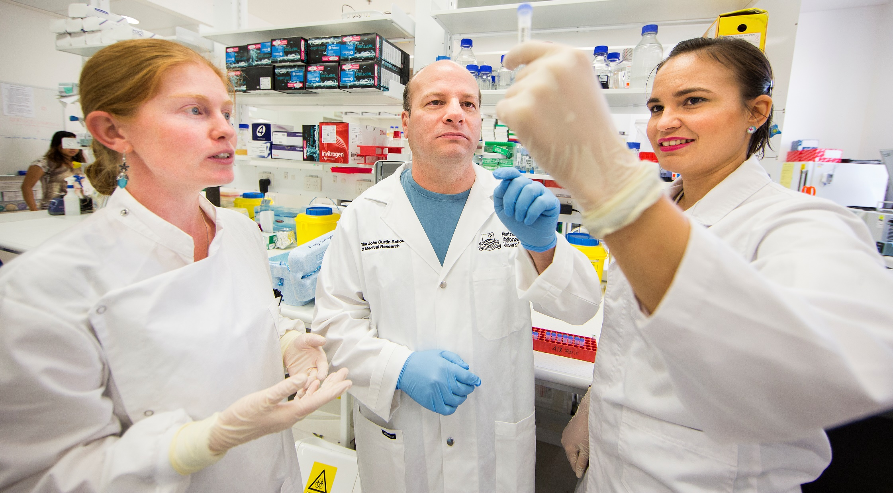
What gender inequities do you see at ANU?
What challenges does your College or School face?
What changes do you want to see occur, to make ANU more inclusive and equitable?
Notes:
Some questions for you to consider. We’d appreciate your feedback and ideas.

Slide 18
📧 Contact us: SAGE@anu.edu.au
🌐 Find out more:
services.anu.edu.au/sage
Notes:
We welcome your feedback on the project, and your suggestions for how we can make ANU a more inclusive and diverse place to work.

