Slide 1
Preparing for Online Events and Our Remote Students
  Ben Wicks – Service Experience

Slide 2
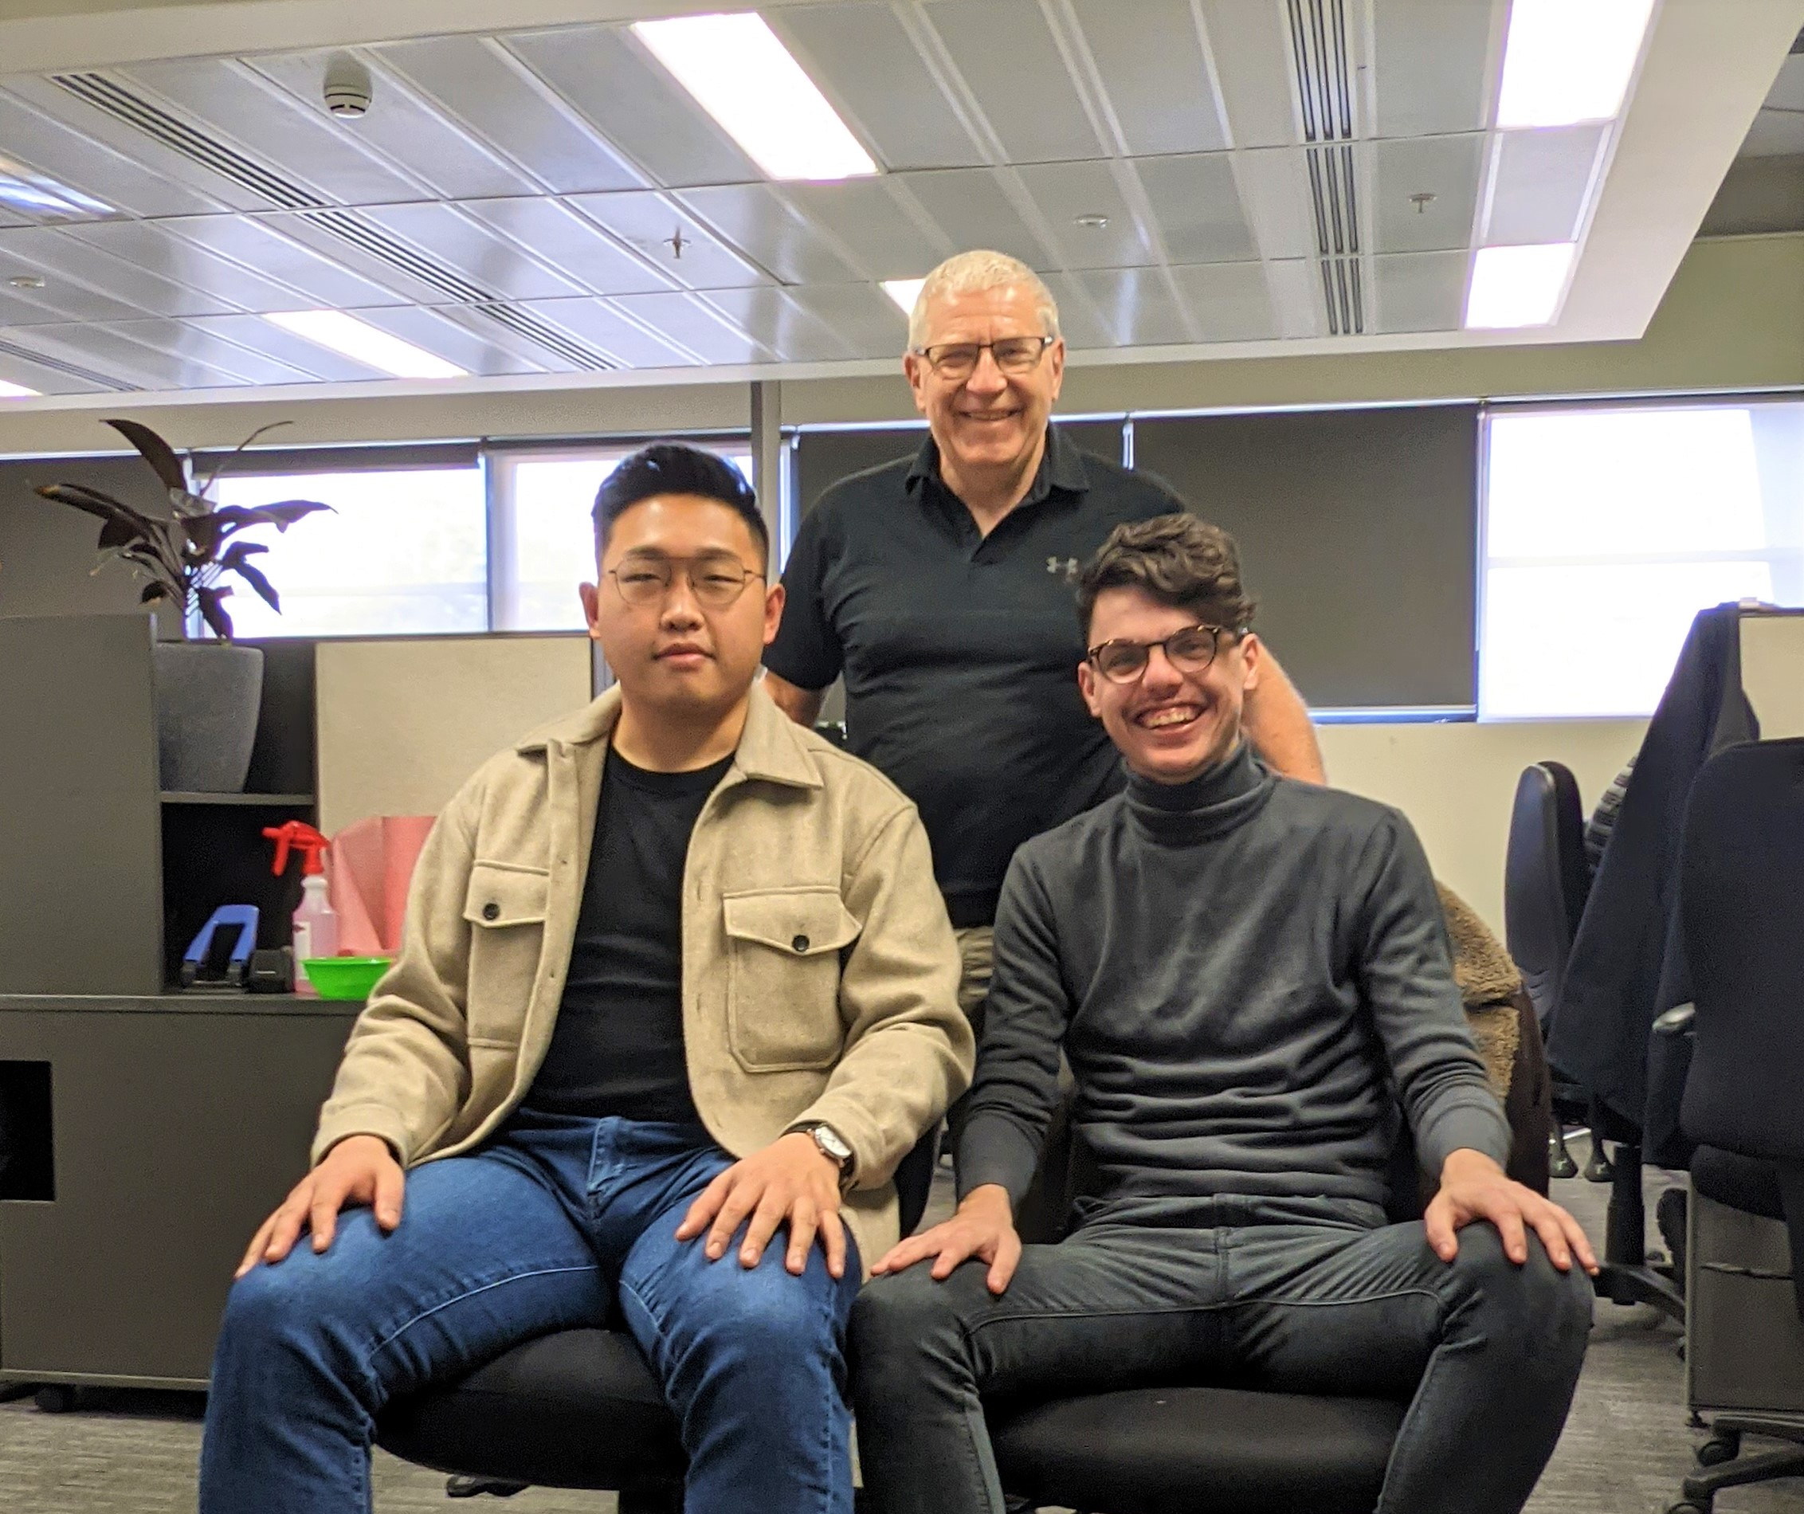
The Service Experience
Team
Planning and Service Performance Division
Pretotyping
Human Centered Design
My Own Personal Experience

Slide 3



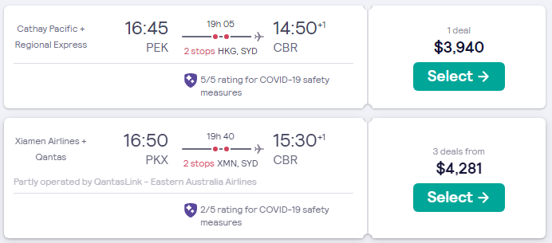
Where are we now?

Slide 4


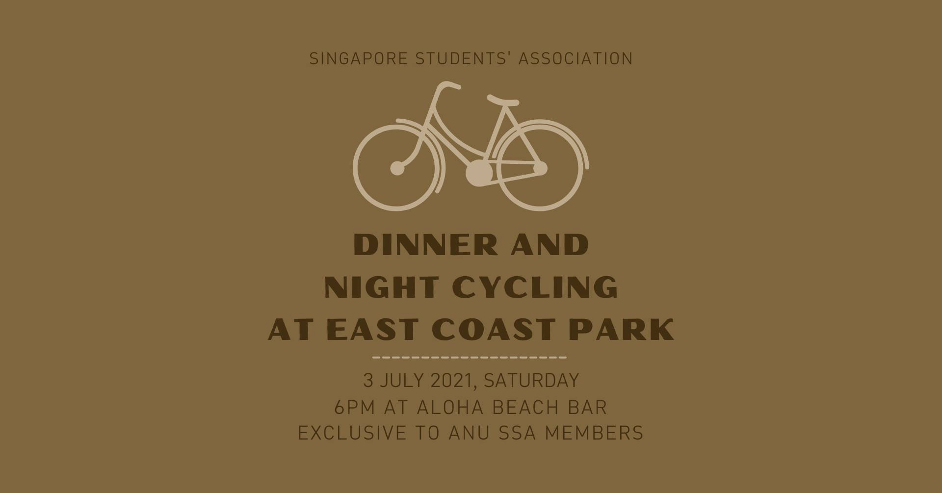
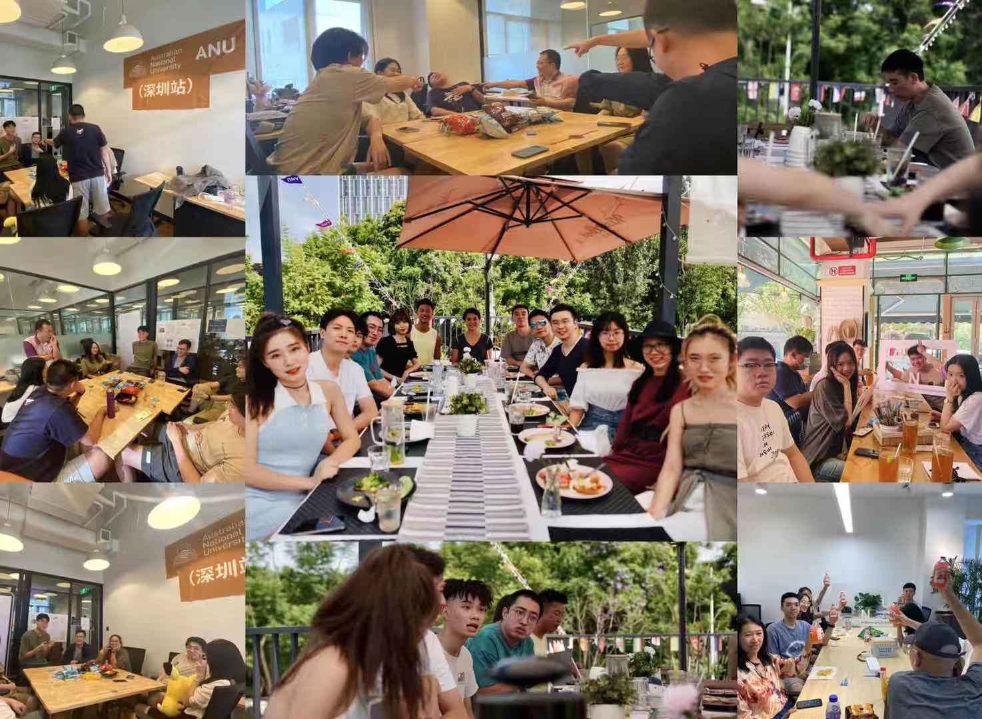
Our Experience With Remote Events

Slide 5
Virtual Events
Promoting Events within Student Spaces
  Facebook “Schmidtposting”
  China Liason Office
  ANUSA Social Media
Designing Events with Students
  Student Clubs and Societies
  Student Staff/Volunteers
Creating a level of engagement when students join
  Avoid the Awkward Silences!

Slide 6

Virtual Education
Applied Market Research (MKTG7060) Case Study
Working through tutorial questions as a group
Tying those things to assessable outcomes
Human Centered Design

Slide 7
ANU Isn’t A Virtual University
Don’t pretend it is one!
Identify where virtual events fail and try improve on it
Recognise with students that these events aren’t perfect
Recognise that these are members of the ANU community

